Slide 1
Progressive Education Society's Modern College of Engineering MCA Department Tourism Management System
Supervised by : - Dr. Prakash Kene [Assistant Professor]
SYMCA- Sem-III(Term-I)
Roll No :-52130,52105,52164.
Submitted by : -
Laxman Kagade
Kalpesh Ahirrao
Hanumant Shinde
Academic Year- 2021-22 (Term-I)

Slide 2
Contents:
Project Introduction
Advantages
Scope of the system
Requirement of the system
Data Flow Diagram
Entity Relationship Diagram
Use case Diagrams
Screen layouts
Conclusion
Future Enhancements
<College_name> <Degree/Year> <Project>

Slide 3
Project Introduction
Tourism management system is used to book a tour from anywhere in the world by a single dynamic website which will help the user to know all about the places and tour details in a single website. The admin can add packages to the website from a certain travel agents and hotels by create a tour page. Then the users can sign in and book each project, they can be confirmed by the admin in their manage booking page. The user can see the confirmation in their my booking page. It is a easiest platform for all travelers which can be easily booked and know the all details.
Tour Management system is a dynamic website for tourism business. It is dynamic and responsive web design. It is also called travel technology solution for agencies & tour operation. Nearly Everyone goes on a vacation for this ‘a Tourism management system’ would play a vital role in planning the perfect trip. The tourism management system allows the user of the system access all the details such as location, events, etc. The main purpose is to help tourism companies to manage customer and hotels etc. The system can also be used for both professional and business trips.
<College_name> <Degree/Year> <Project>

Slide 4
Advantages:
Gives accurate information.
Simplifies the manual work.
It minimizes the documentation related work.
Provides up to date information.
Friendly Environment by providing warning messages.
Travelers details can be provided.
Booking confirmation notification.
<College_name> <Degree/Year> <Project>

Slide 5
Scope of the system:
The need for a tourism management system that can manage tourism information with ease is sought after by every tour management company.
Tour Management system is a dynamic website for tourism business.
This travel and tourism application is designed for travel agencies by which they can manage different tour packages based on the destinations.
By using this, the tour company can tailor tour packages spanning various destinations at almost every price point. The also implemented search module allows the administrator to find and update or upgrade the tour packages with ease.
<College_name> <Degree/Year> <Project>

Slide 6
Requirement of the system:
Hardware requirements are as follows:
Pentium IV Processor
512 MB RAM
40GB HDD
1024 * 768 Resolution Color Monitor
<College_name> <Degree/Year> <Project>

Slide 7
Software Requirement
Software Requirement as follows:
1. OS : Windows 7, 10
2. PHP.
3. HTML, CSS, Javascript
4. Database: MySql
5. Editor: Notepad, Visual Studio Code, Sublime Text.

Slide 8
Existing features:
Administrative Features :
Managing Packages, Users, Booking.
Manage Issues, Enquires, Pages.
User :
Signup, Signin, Forget Password, Update Profile, Tour History, Change Password, Raise Issue, Booking.
Guest :
Guest user can visit the website and view the all content of website. Guest user can also Enquiry.

Slide 9
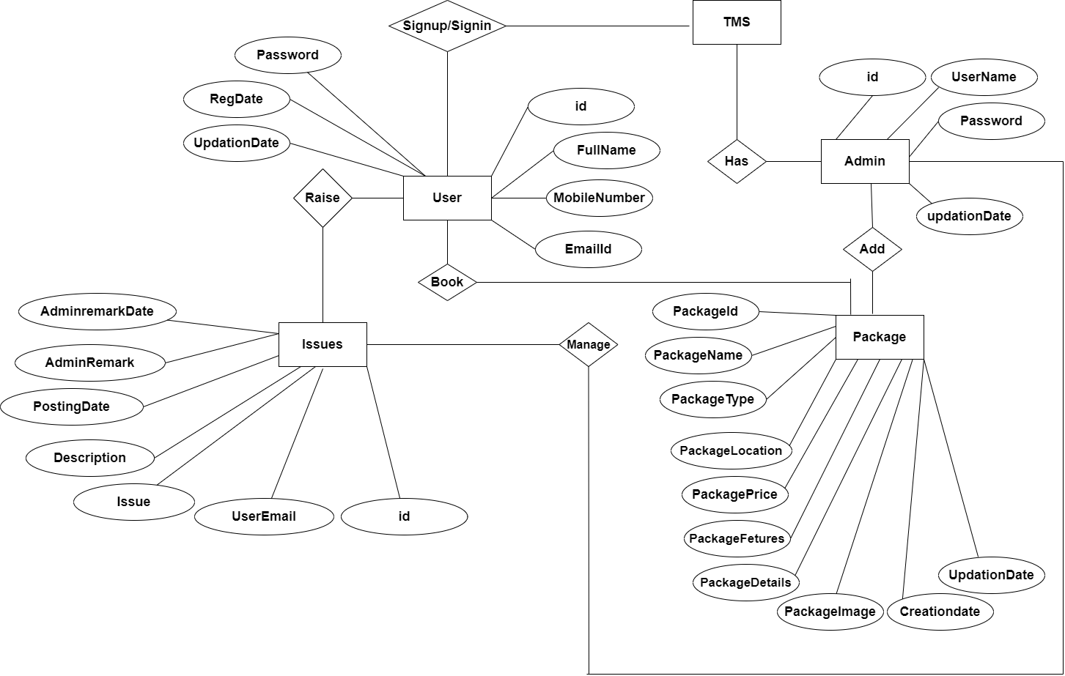
Entity Relationship diagram

Slide 10
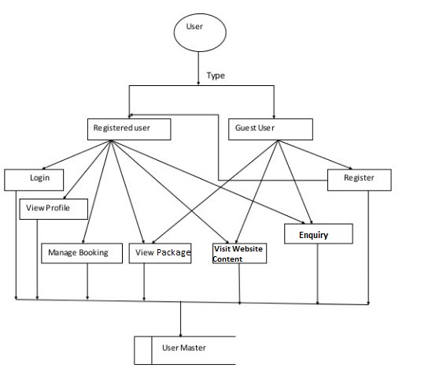
Data Flow Diagram: User:

Slide 11
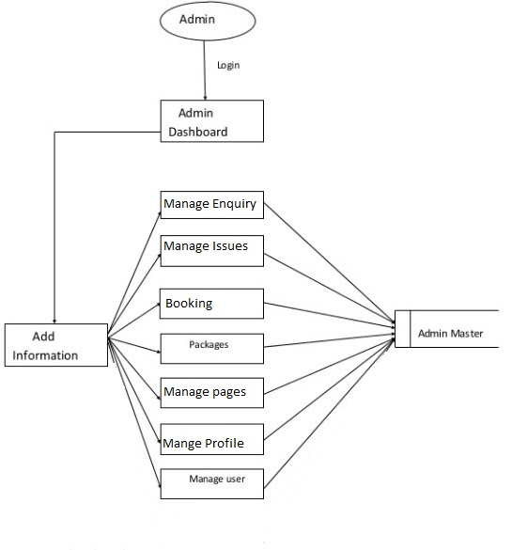
Admin:

Slide 12
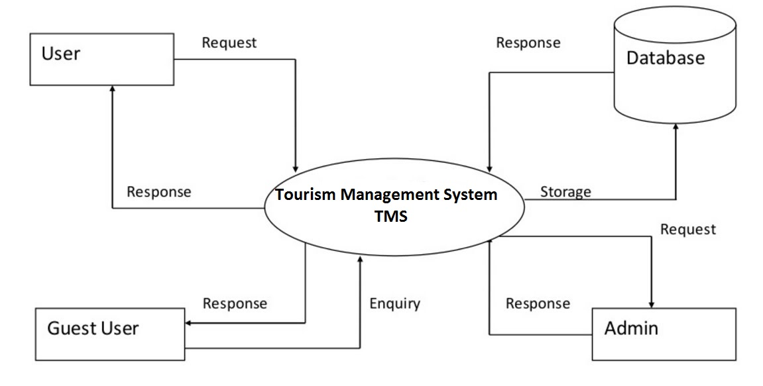
System:

Slide 13
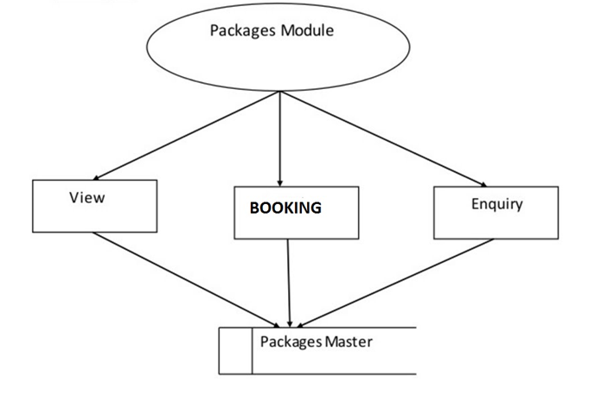
Package:

Slide 14
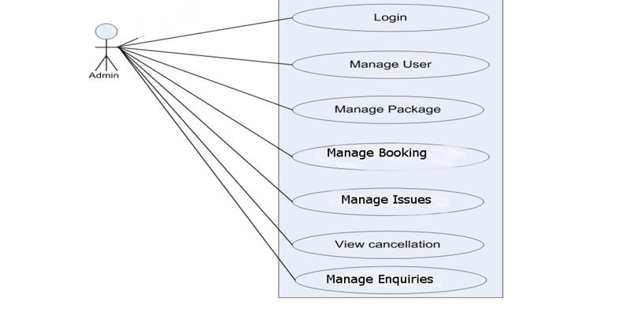
Use case Diagrams: Admin:

Slide 15
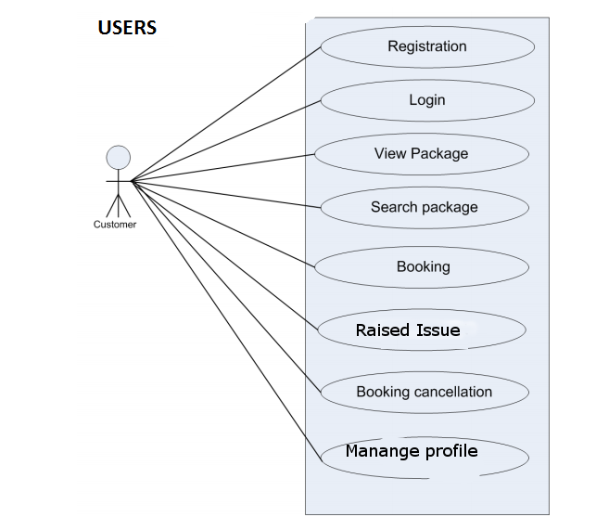

Slide 16
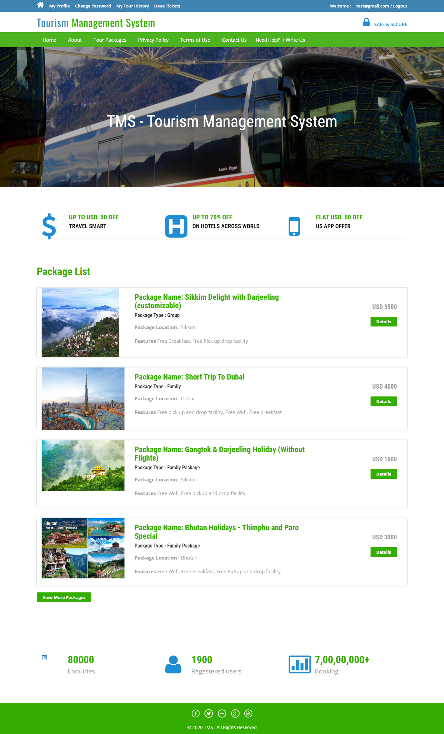
Screen Layout: Home Page
<College_name> <Degree/Year> <Project>

Slide 17
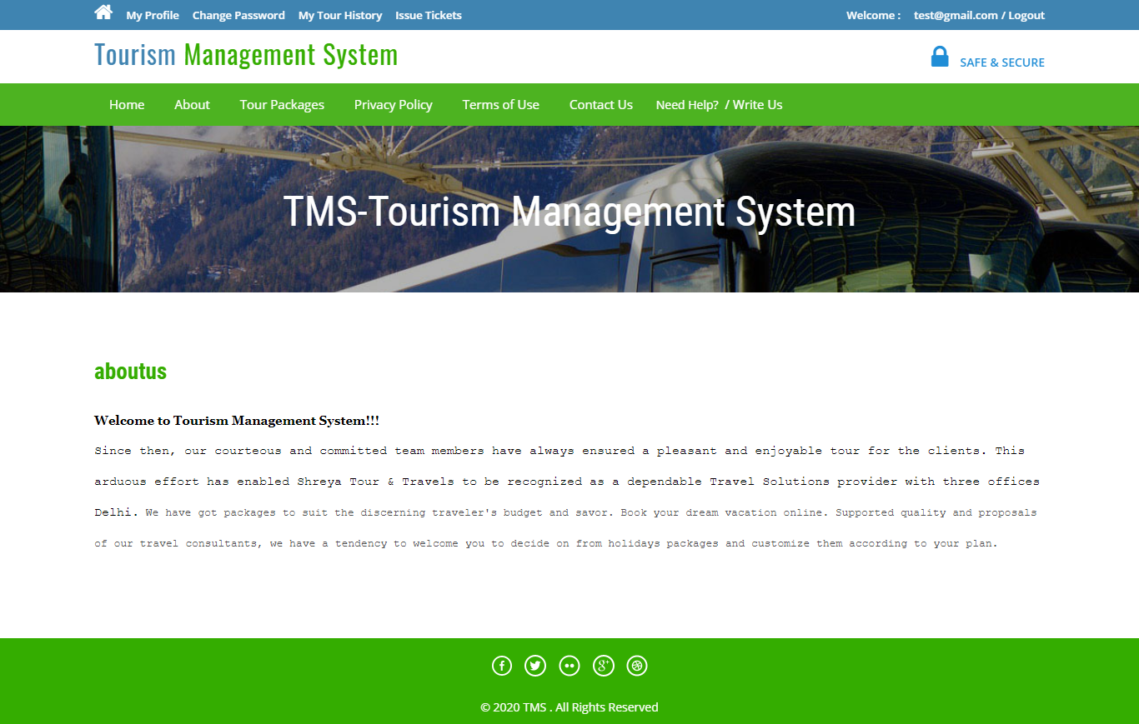
About Us:

Slide 18
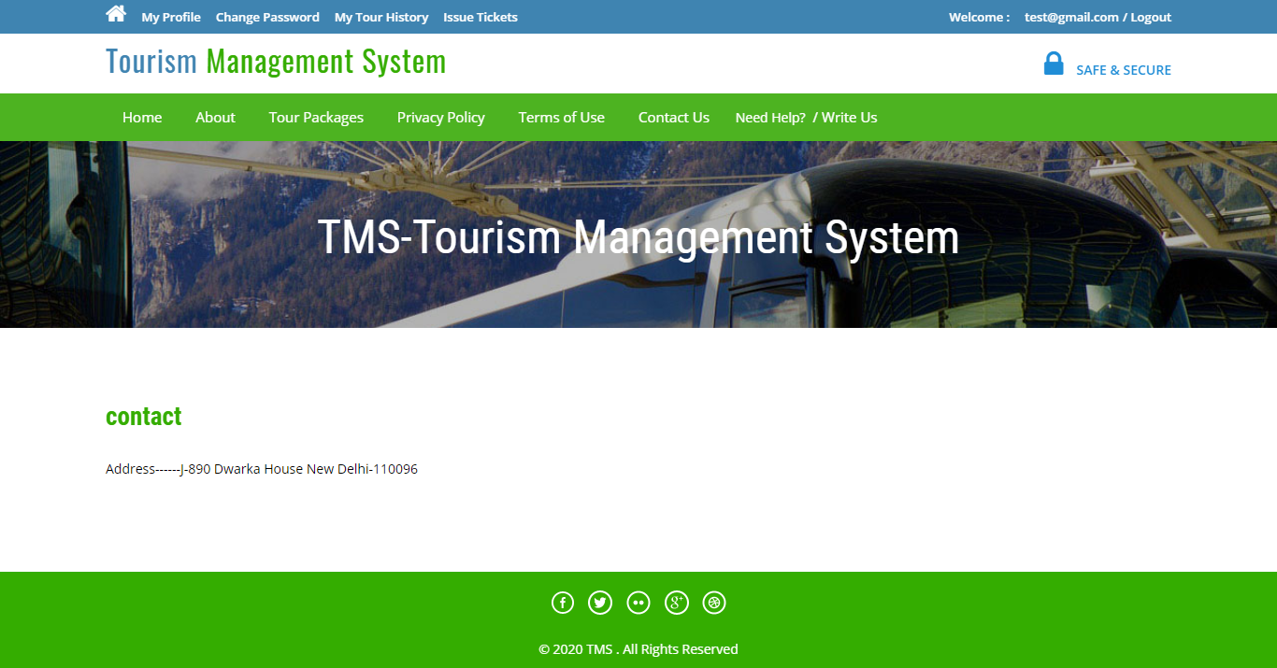
Contact Us:

Slide 19
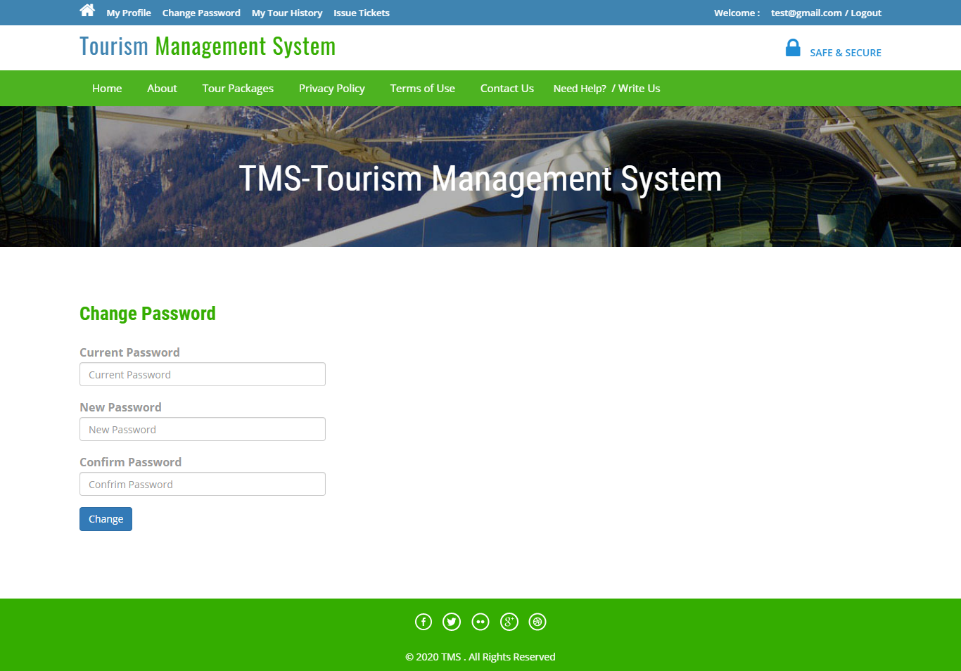
Change Password:

Slide 20
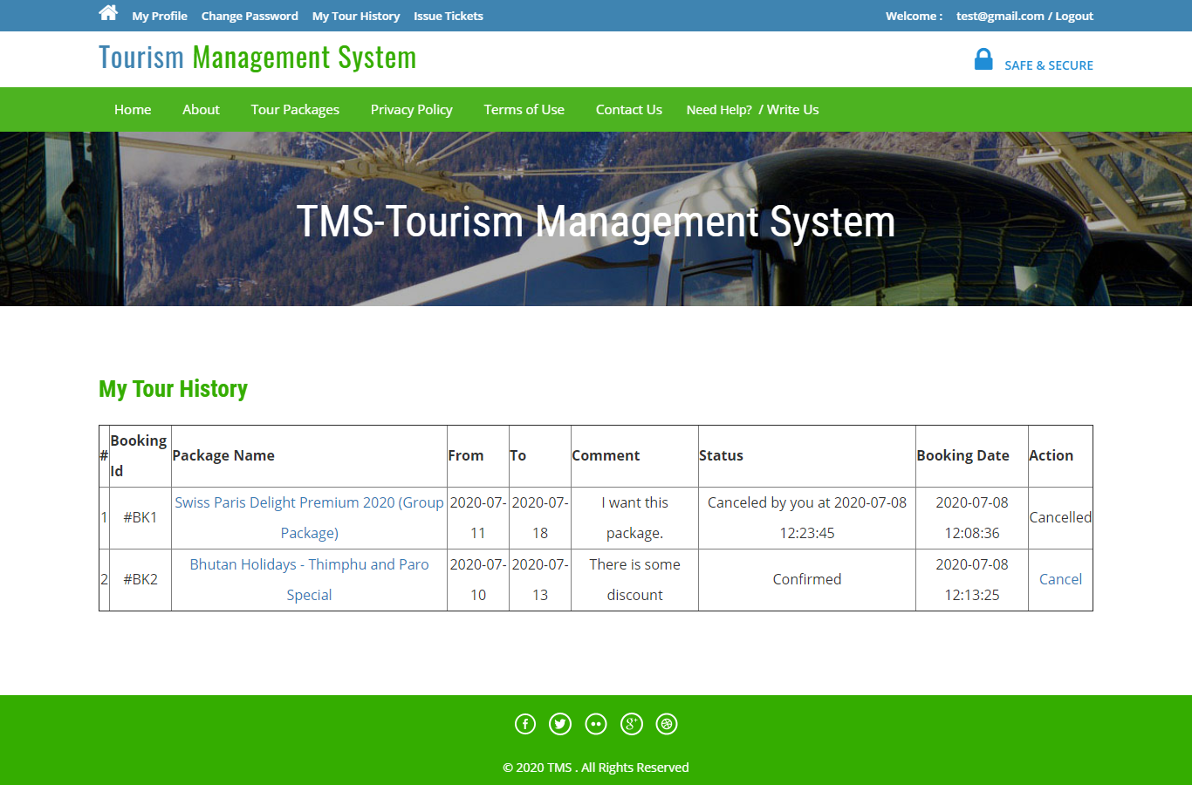
User Tour History:

Slide 21
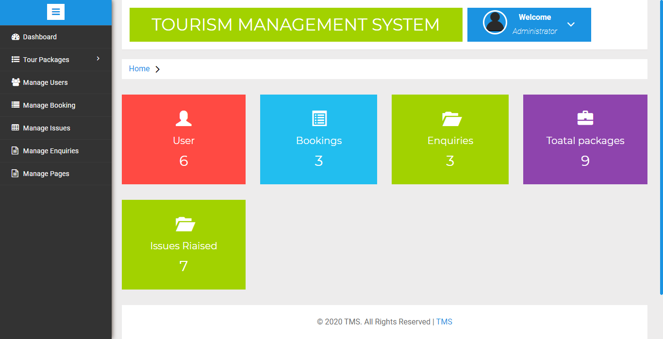
Admin Dashboard:

Slide 22
Conclusion:
This web application was successfully created and stored all the travel admin tourism packages booking, creation managing and tour details into the database using this application.
The application was tested very well and the errors were properly debugged. Testing also concluded that the performance of the system is satisfactory. All the necessary output is generated. This system thus provides an easy way to automate all the functionalities of consumption.
If this application is implemented in few consumption, it will be helpful. Further enhancements can be made to the project, so that the website functions in a very attractive and useful manner than the present one. It is concluded that the application works well and satisfy the.

Slide 23
Future Enhancements:
It is worth mentioning that this project work is open for further enhancement, with the expectation that it becomes more robust and better enhanced; covering every single tourist sites. For a modified system, the user need to just login into the application and can find the routes, costs, hotels, adventure sports, transportations and book immediately and complete the booking process for a successful transaction.
In the aspect of tourism, Internet and web technologies have made more readily available information on tourist locations, accommodations, transportation, shopping, food, festivals, and other attractions, thus improving the whole tourism experience.

Slide 24
!!Thank you!!

